Slide 1
Network Aware Load-Balancing via Parallel VM Migration for Data Centers
Kun-Ting Chen, Chien Chen, Po-Hsian Wang
Presented by: Katya Rodriguez
Ahmed Alsuwat
Saud Tawi
05.06.15

Slide 2
Content
Introduction
Related Works
Network-Aware Bipartite Matching Load-Balancing Algorithm
Findings
Contribution to the Field
Criticism/Future Work?
Questions

Slide 3
Introduction
Data Center: A large group of computers/servers that are networked. These can be used by organizations to process, distribute large amounts of data and remote storage.
Cloud data centers use virtualization-based technology for the sole purpose of consolidating hardware resource usage.
This provides application hosting for multiple service providers.
Without proper allocation, the loads of different resources may become unbalanced among different physical hosts.

Slide 4
Introduction
Currently, the existing algorithms for load balancing search for a VM to begin a migration.
The selection of the next migration doesn’t occur until after the previous migration has completely ended (AKA sequential migration).
Most existing algorithms ignore the time it takes to reach a balanced state.
Proposal: an algorithm that minimizes joint multi-resource imbalance and the time it takes to reach a balance state.

Slide 5
Introduction
This method doesn’t degrade application performance.
Uses Hungarian method, bipartite graph and network topology that is aware of parallel migration (Network-Aware Bipartite Matching Load Balancing Algorithm –NABM).

Slide 6
Introduction
Hungarian Method
Cheapest Job = $7.00
Jim – Clean Bathroom ($3)
Steve – Sweep floors ($2)
Alan – Wash Windows ($2)

Slide 7
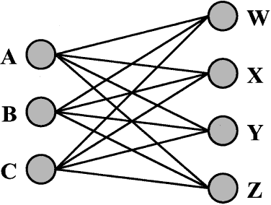
Introduction
Bipartite graphing
Separation of one big group into two.
Purpose is so the two groups can connect with each other.

Slide 8
Related WORKS
Many of the previously proposed load balancing schemes for cloud computing measure the load on physical hosts differently.
Zhao and Huang use the number of VMs of a host as their load measurement.
VectorDot (VD) brings down threshold by migrating on or more VMs sequentially.
Process is repeated until no more overloaded hosts.

Slide 9
Related Works
Even though currently the modern cloud administrators migrate multiple VMs concurrently, migration still has a chance to degrade into sequential migration.
Still the issue is not address of how long it takes to balance the load.

Slide 10
Network-Aware Bipartite Matching Load Algorithm
3 Decision policies are used to construct graph.
Participation: In charge of deciding which hosts are participating in the balancing of load.
Checks host for resource utilization (u) and according to the load it classifies it as a trigger node (t)
Checks if host is not an element of trigger node. If it isn’t then classified as nontrigger node.

Slide 11
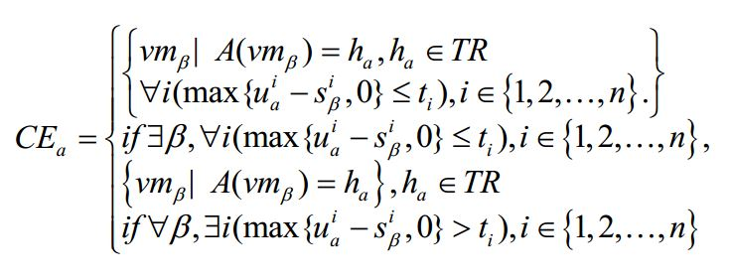
Network-Aware Bipartite Matching Load Algorithm
Candidate policy: Chooses which vms to transfer from in order to alleviate overload.
Checks if host is element of trigger node
Checks resource utilization against threshold of host
If resource utilization greater, then vm is candidate set

Slide 12
Network-Aware Bipartite Matching Load Algorithm
Location policy: Selects destination vm for unloading.
After selection, a non trigger node can have many trigger nodes wanting to unload on it.
Checks resource utilization against threshold of host
If less than host, then is a part of the non trigger node.

Slide 13
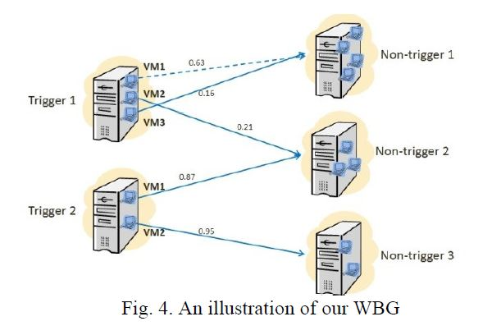
Network-Aware Bipartite Matching Load Algorithm
Solid edge smaller weight than dotted edge. Checks resources given to resources in empty node.
Network is configured so not that many hops are given when transferring from trigger nodes to non trigger nodes.

Slide 14
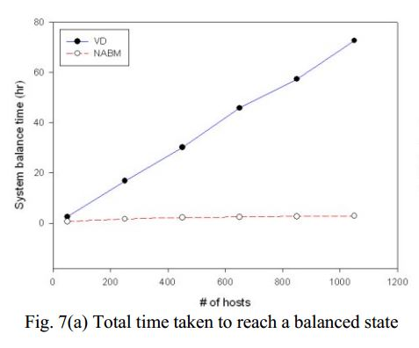
FINDINGS
Network-Aware Bipartite matching (NABM) allows the system to strike a balanced state quicker than allowed by VectorDot (VD).
The graph states that as the number of hosts is increased, the time taken by NABM to reach a balanced state remains more or less the same, but the time taken by VD increased almost proportionally.

Slide 15
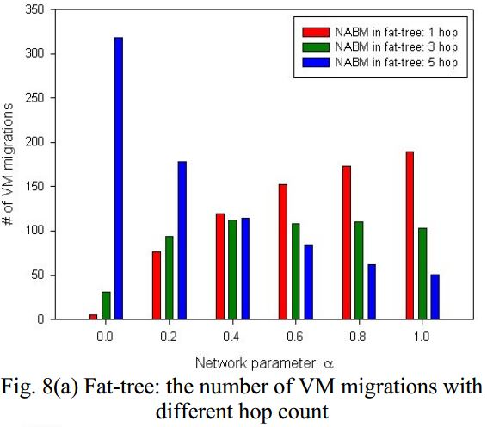
FINDINGS

Slide 16
Contribution to the Field
Viability and usefulness of the parallel VM migration for data centers in managing load.
Existing load management systems of virtual data centers do not ensure reliable throughput, swift handing of job queues by servers and fast attainment of balanced state.

Slide 17
Contribution to the Field
Handles multiple migrations of VMs at one time
Reducing downtime
Increasing service efficiency
By adapting parallel VM migration, the data can be migrated from one center to another very quickly.
It enhances the ability of the cloud computing technology to foil data theft attempts.
A sustained balanced state, under parallel VM migration, cuts down the cost of system maintenance arising out of frequent system breakdowns, hotspots and over usage of resources.

Slide 18
Criticism/future work?
It seems like this algorithm only allows one trigger node to be unloaded to one non trigger node.
What is non trigger node had more memory? More resources?
What about power consumption?
How does this algorithm affect the power consumption in the virtual data centers
Power consumption also important for companies.

Slide 19
Questions?

