Slide 1
Implementing Parallel processing of DBSCAN with Map reduce
Garrett Poppe, Liv Nguekap, Adrian Mirabel
CSUDH, Computer Science Department

Slide 2
Overview
Introduction to the topic
History and related work
Problem definition
Existing approaches to solving the problem
Description of proposed algorithm
Problems and solutions
The trend of the field
Conclusion

Slide 3
Introduction
Density-based spatial clustering of applications with noise (DBSCAN) is a data clustering algorithm proposed 1996.[1]
“It is a density-based clustering algorithm: given a set of points in some space, it groups together points that are closely packed together (points with many nearby neighbors), marking as outliers points that lie alone in low-density regions (whose nearest neighbors are too far away).”
“DBSCAN is one of the most common clustering algorithms and also most cited in scientific literature.”[2]
“In 2014, the algorithm was awarded the test of time award (an award given to algorithms which have received substantial attention in theory and practice) at the leading data mining conference, KDD.”[3]

Slide 4
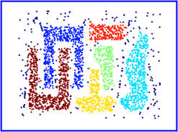
Introduction

Slide 5
Motivation
Census survey data

Slide 6
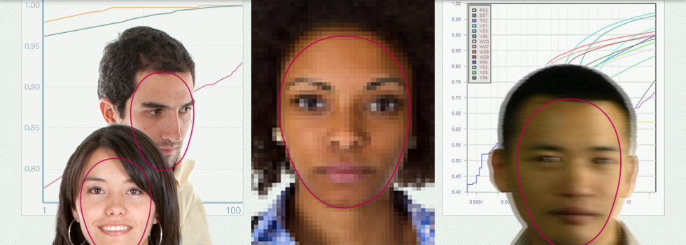
Motivation
Face recognition(FaceVACS-DBScan)

Slide 7
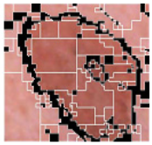
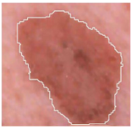
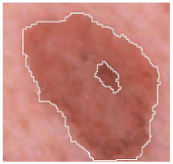
Motivation
Mining Biomedical Images with Density-based Clustering

Slide 8
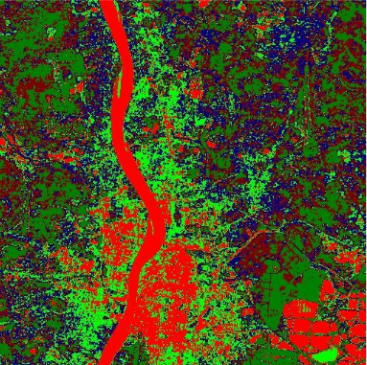
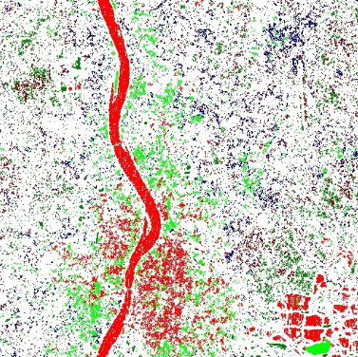
Motivation
Satellite image recognition

Slide 9
Problem
O(nlog(n)) Best case
O(n²) Worst case
Current algorithms are done as a single task
Algorithm starts with first point and continues comparing to last point
Requires user to input minPts and Eps
Parallelization of DBSCAN is challenging as it exhibits an inherent sequential data access order.

Slide 10
Approaches to solve problem
CURE utilizes multiple representative points for each cluster that are generated by selecting well scattered points from the cluster and then shrinking them toward the center of the cluster by a specified fraction. This enables CURE to adjust well to the geometry of clusters having non-spherical shapes and wide variances in size.
PDSDBSCAN using graph algorithmic concepts and using a tree-based bottom-up approach to construct the clusters, yields a better balanced workload distribution. Implementation of the algorithm both for shared and for distributed memory.

Slide 11
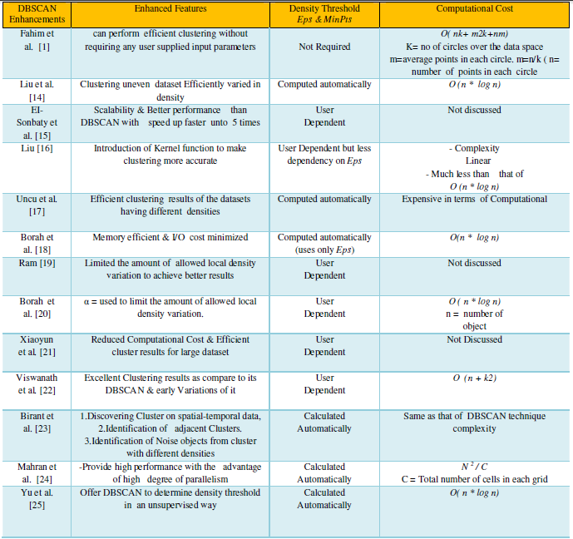
Current

Slide 12
Proposed Algorithm (Data Set)

Slide 13
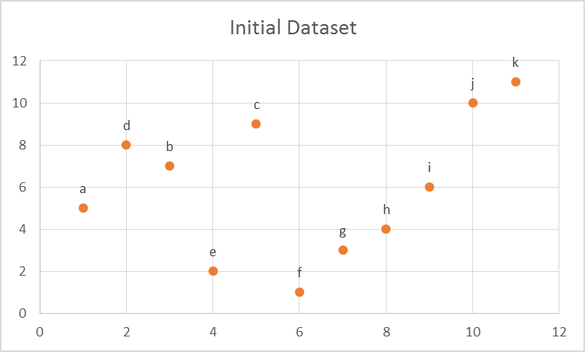
Proposed Algorithm (Data Set)

Slide 14
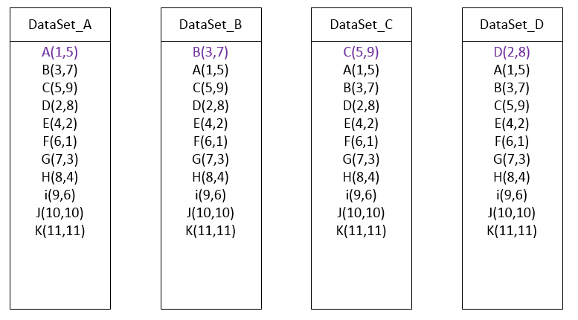
Proposed Algorithm (Map Tasks)

Slide 15
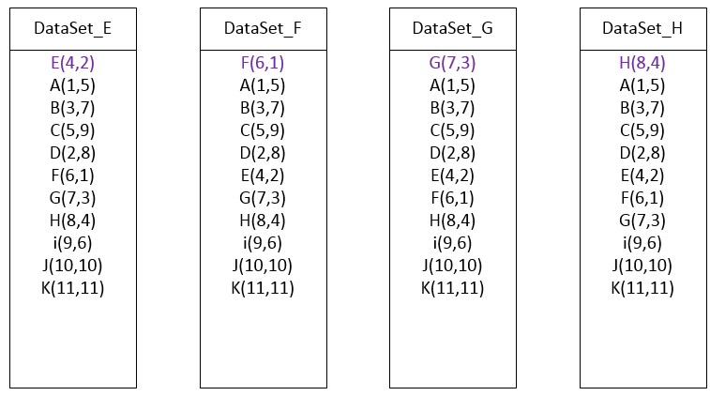
Proposed Algorithm (Map Tasks)

Slide 16
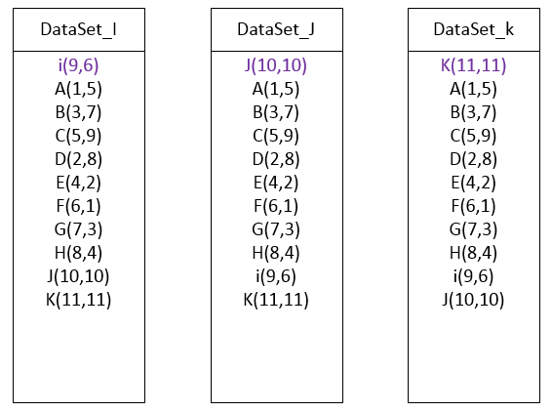
Proposed Algorithm (Map Tasks)

Slide 17
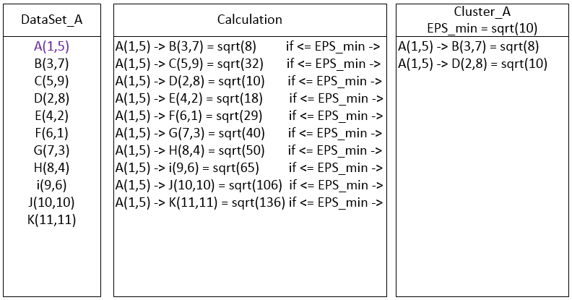
Proposed Algorithm (Map Function)

Slide 18
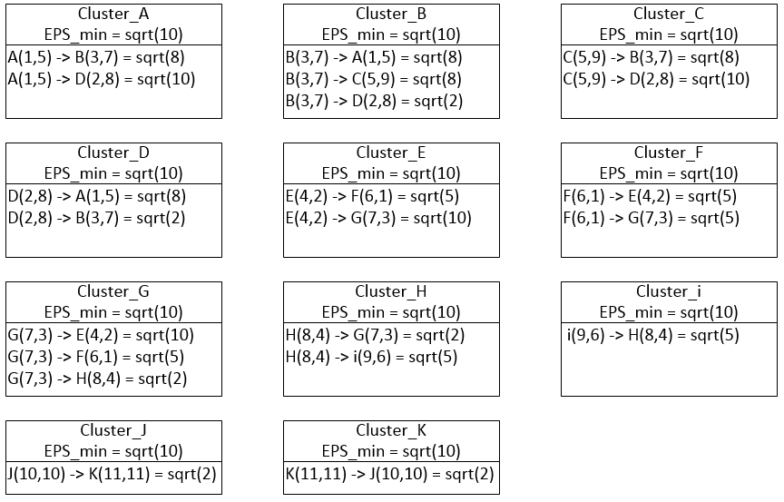
Proposed Algorithm (Map Function Results)

Slide 19
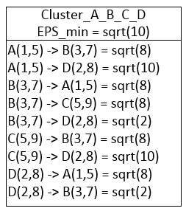
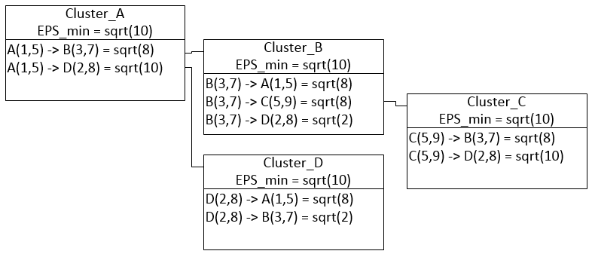
Proposed Algorithm (Reduce Function)
If MIN_pts = 2
Start at first cluster table.
Visit each cluster within table.
Add all points from visited table to first cluster table.
When all points are visited go to next unvisited cluster table.
Repeat step 1 until all tables are visited.
Omit any noise tables (a cluster table with less than 2 points).

Slide 20
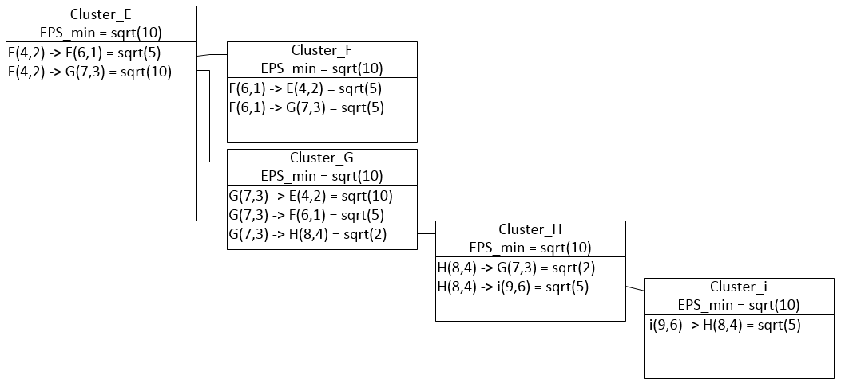
Proposed Algorithm (Reduce Function)

Slide 21
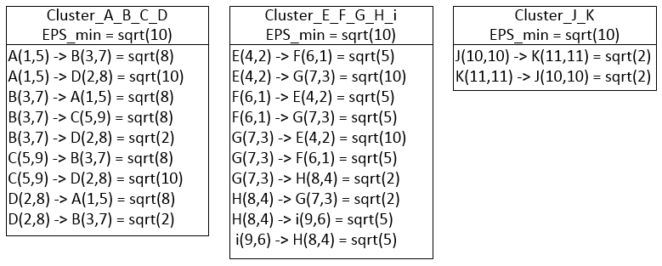
Proposed Algorithm (Final Clusters)

Slide 22
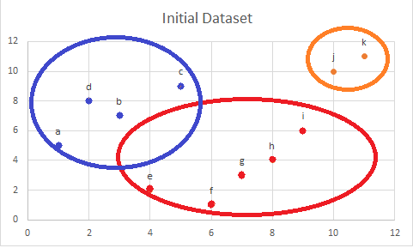
Proposed Algorithm (Final Clusters)

Slide 23
Proposed Algorithm (MIN_pts)
Clusters that do not contain the minimum number of points within the EPS_min, will be dropped during the reduce phase.
If MIN_pts = 4
Check ptsCntr for each cluster table visited and add only ptsCtr if it is > 4

Slide 24
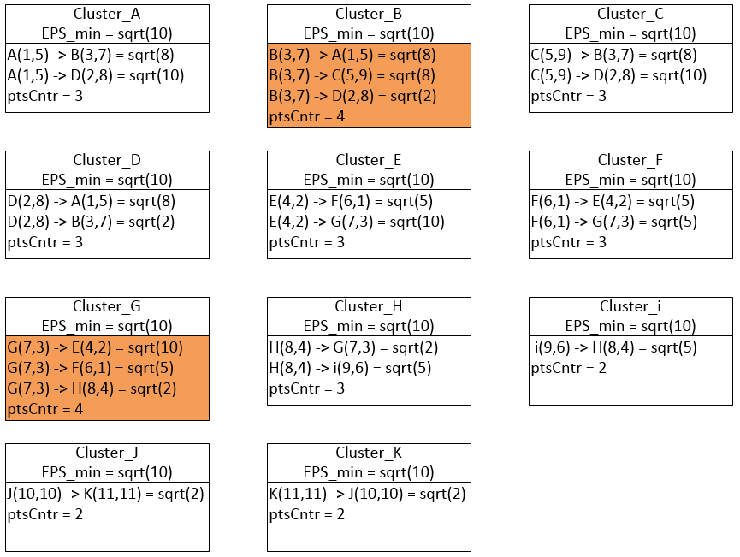
Proposed Algorithm (MIN_pts)

Slide 25
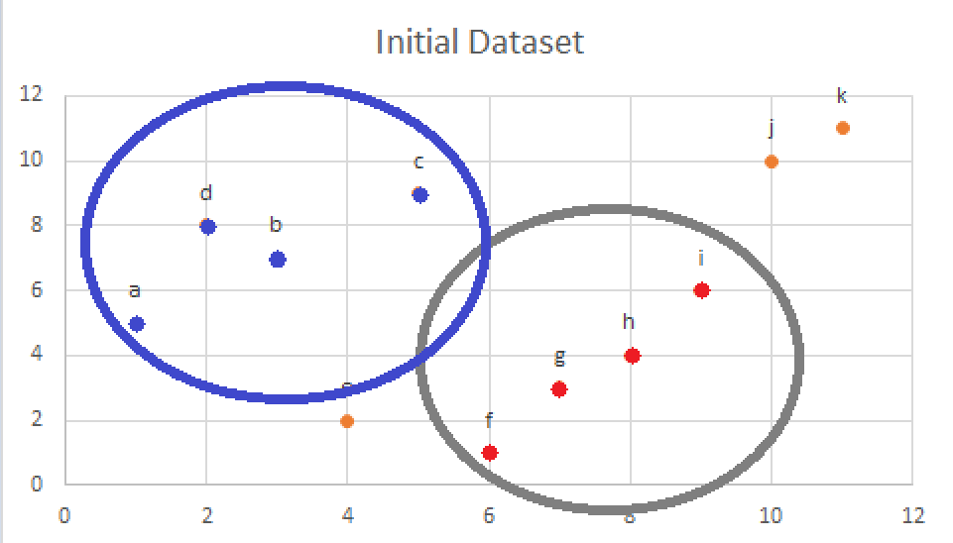
Proposed Algorithm (MIN_pts)

Slide 26
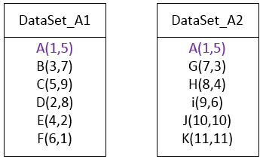
Anticipated problems and solutions
Dataset is too large for memory of a single node.
Split dataset into portions where the origin point is compared with each split during the map phase.
Combine all clusters created from split dataset during the reduce phase.

Slide 27
Trends and future research
Big Data requires parallel processing
Data collected is outgrowing processing power
Machine learning and AI can fill the need for analysis of large amounts of data

Slide 28
References
http://biarri.com/spatial-clustering-in-c-post-2-of-5-running-dbscan/
http://citeseerx.ist.psu.edu/viewdoc/download?doi=10.1.1.68.2719&rep=rep1&type=pdf
http://ieeexplore.ieee.org/stamp/stamp.jsp?arnumber=6814687&tag=1
http://delivery.acm.org/10.1145/2390000/2389081/a62-patwary.pdf?
[1] Ester, Martin; Kriegel, Hans-Peter; Sander, Jörg; Xu, Xiaowei (1996). Simoudis, Evangelos; Han, Jiawei; Fayyad, Usama M., eds. A density-based algorithm for discovering clusters in large spatial databases with noise. Proceedings of the Second International Conference on Knowledge Discovery and Data Mining (KDD-96). AAAI Press. pp. 226–231. ISBN 1-57735-004-9. CiteSeerX: 10.1.1.71.1980.
[2] Most cited data mining articles according to Microsoft academic search; DBSCAN is on rank 24, when accessed on: 4/18/2010
[3] "2014 SIGKDD Test of Time Award". ACM SIGKDD. 2014-08-18. Retrieved 2014-08-22.

